Slide 1
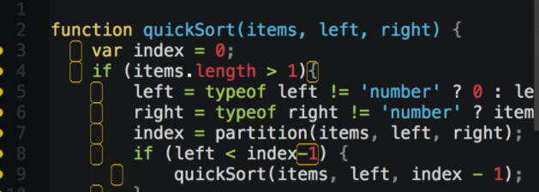
JavaScript Training
JS is not perfect but works
Krzysztof Danielewicz
Special thanks to: Maracelina Skopek-Szemik, Anton Horetskyi

Slide 2

About me
.Net developer with 7 year experience
Expertise in Front-end technologies: JS, AngularJS, Angular, CSS
Current assignment TCO – Total Cost of Ownership for Volvo Penta
  Offline Web App in technologies: AngularJS, Angular 5, Kendo.

Slide 3

Agenda
Javascript in Web Applications
  Practical example
Understanding JS
  scopes, hoisting
ECMAScript5
  array functions, strict mode
Future and necessary fixes
  ECMAScript2015, TypeScript, Transpilers

Slide 4
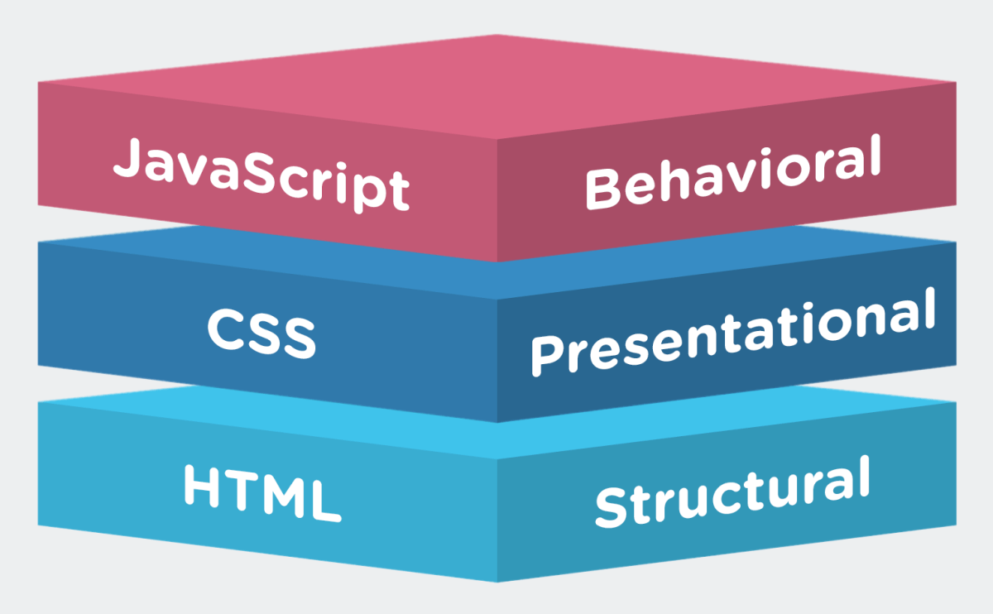

Javascript in Web Applications

Slide 5
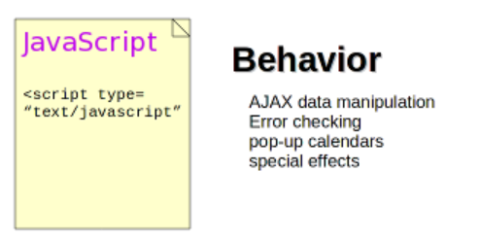
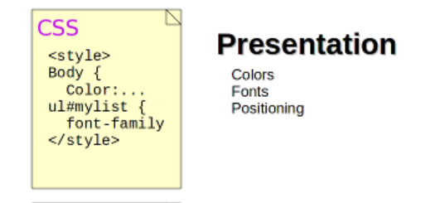

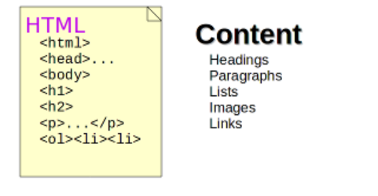
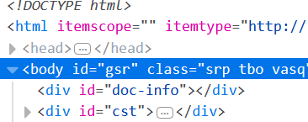
Notes:
http://yoanacreates.com/css-zen-garden/index.html

Slide 6

Scopes of variable
JavaScript has only two types of scope:
Global scope – global is nothing but a window level scope. Here, variable present throughout the application.
Functional scope – variable declared within a function with var keyword has functional scope. Variable declared there are not visible outside.
Notes:
Variable declared in global scopes are avilable
JS Syntax is similar to C syntax languages (Java, C#). Syntax is the same for statements i.e.: while, for, if and function.
lock statements apart from “function” have different behaviour to the modern languages. They do NOT create local scopes with var statement.

Slide 7

“function” create a scope
var temp = ‘OUTER’;
function f1() {
var temp = ‘INNER’;
}
f1();
console.log(temp); // Console prints: ‘OUTER';
Notes:
In this case the global variable temp overrides inside function

Slide 8

“for”, “if”, “while” don’t create a scope
var temp = ‘OUTER’;
for / if / while (…) {
var temp = ‘INNER’;
}
f1();
console.log(temp); // Console prints: ‘INNER';

Slide 9
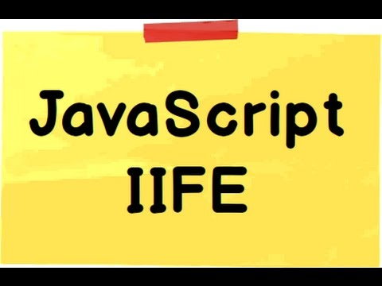
IIFE
Immediately Invoked Function Expressions
IIFE is a JavaScript function that runs as soon as it is defined.
(function(){
})();
Notes:
Why would you use if?
To Avoid Polluting the Global Scope.
To fix issues with blocks: if, while, for,

Slide 10

Fix with IIFE
var temp = 'outer';
for / if / while (…) {
(function () {
var temp = 'inner’;
})();
}
console.log(temp); // Console prints: 'outer'
Notes:
There is A LOT of closure, function in JS.

Slide 11

ES2015 – let + const = JS safe scope
ECMAScript 2015 (ES2015/ES6): The 6th edition of ECMAScript, standardized in 2015
ECMA2015 introduces let and const keywords which create scopes for variables and constant in block statements: if, while, for.

Slide 12
Fix with let
var temp = 'outer';
for / if / while (…) {
let temp = 'inner’;
}
console.log(temp); // Console prints: 'outer'

Slide 13

Hoisting
JavaScript mechanism where variables and function declarations are moved to the top of their scope before code execution.
Notes:
Examples: hosting.js, hosting.2.js

Slide 14

JS standards – ECMAScript
Standard | Year | Browser support | Major featurs added | Enterprise mode (IE8)
ECMAScript 3 | 1999 | Older browsers | Regular Expressions, try/catch | Yes
ECMAScript 5 | 2009 | IE11, all suported browsers | "strict mode", array functions | No
ECMAScript 2015 | 2015 | 96%-99% evergreen browsers | Classes and modules. | No
ECMAScript 2016 | 2016 | 72%-87% evergreen browsers | exponential operator, Array includes | No

Slide 15

ECMAScript5 – C# Linq vs array functions
C# | ECMAScript5
Where() | filter()
Select() | map()
Any() | some()
All() | every()
Aggregate() | reduce()
ForEach() | forEach()

Slide 16
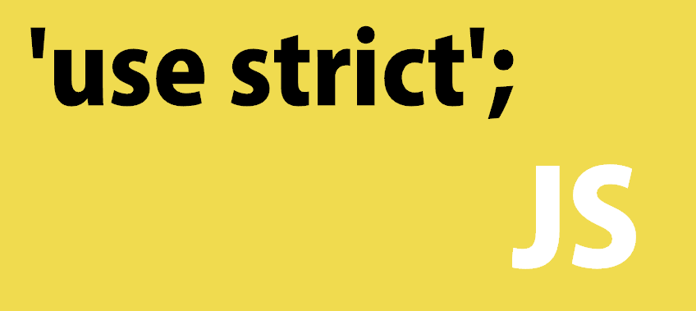
ECMAScript5 – strict mode
Strict mode is a way to introduce better error-checking into your code.
Put in the beginning of the file or the function:
“use strict”;
Recommended only for new code and inside iife. Strange bugs / behavior for legacy code when is turned of.

Slide 17
Strict mode – ECMAScript5
Restrictions:
Using a variable without declaring it.
Writing to a read-only property.
The value of this is not converted to the global object when it is null or undefined.
Deleting a variable, a function, or an argument.
Notes:
Pragma strict is a way to tell javascript to "be a stricter compiler". That is, it should throw errors when you try to do dumb things that javascript allows. C# is by nature "stricter" and doesn't need to be told to do that.

Slide 18
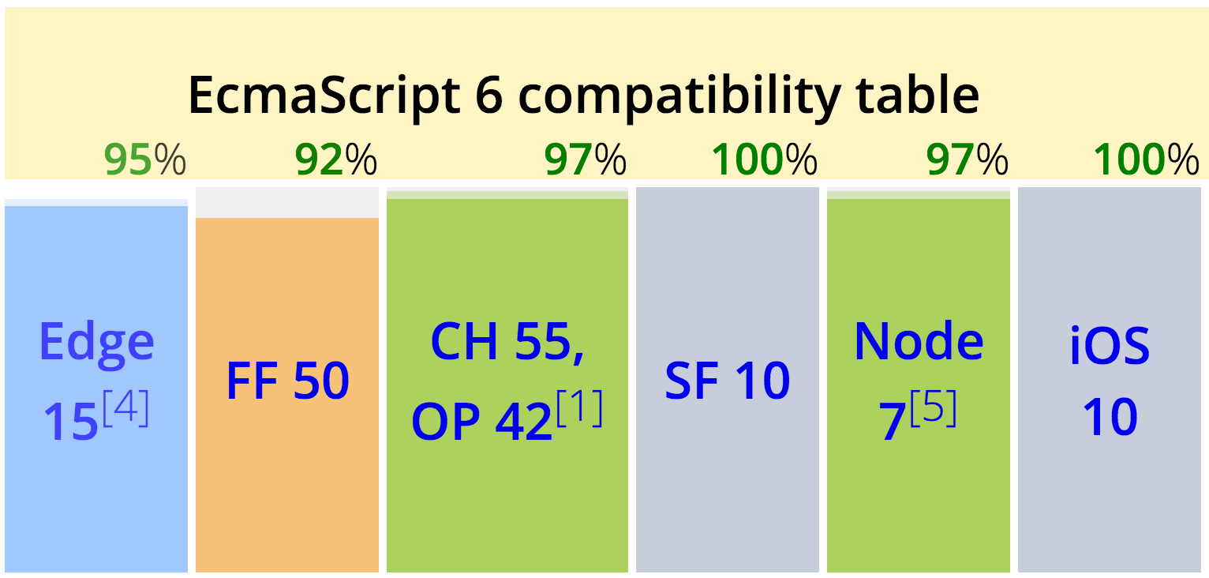
Future – ECMAScript 2015 (ES2015)
Arrow functions
Classes
Template strings
Let + Const
Iterators + For … Of
Modules and much more…
Notes:
Classes doesn’t have private methods

Slide 19


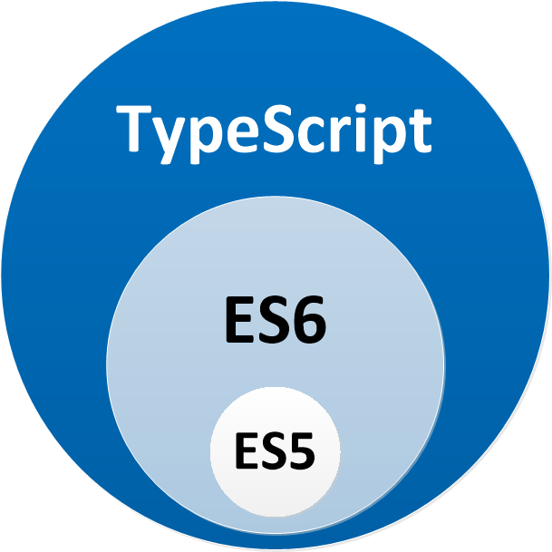

Code with static typing
Annotations
Interfaces, enums
Intellisense
Await / Async
Notes:
7 apr 2017 ,TS is official lang in Google.

Slide 20


Hybrid solutions – Transpilers
  TypeScript
    Tools: node.js tools, Visual Studio, VS Code
    allow-js option, type definitions
  ECMAScript 2015 (ES6)
    BabelJS
  Output code is targeting standards :
    ES 3, ES 5, ES 2015

Slide 21

Q&A
Q &A

Slide 22
References
Code + Presentation: https://github.com/dankrz/JsTraining
https://github.com/lohithgn/Kendo-UI-Web-Sushi
http://www.csszengarden.com/
https://github.com/indexzero/http-server

Slide 23
References
https://app.pluralsight.com/library/courses/javascript-from-fundamentals-to-functional-js/table-of-contents
https://developer.mozilla.org/
https://babeljs.io/learn-es2015/
https://www.typescriptlang.org/
“JavaScript: The Good Parts”, by Douglas Crockford

Slide 24


